Slide 1
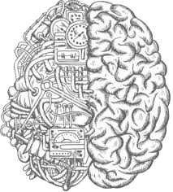
Convolutional Neural Networks and Tensorflow

Slide 2

Used for
Classifying images
1
Cluster them by similarity
2
Perform object recognition within scenes
3

Slide 3
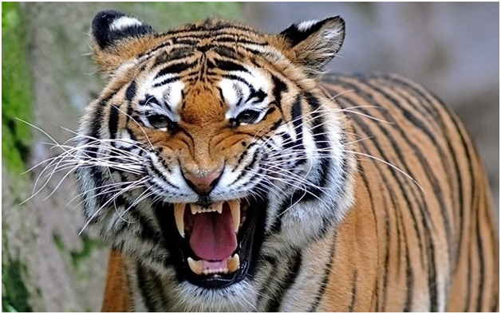
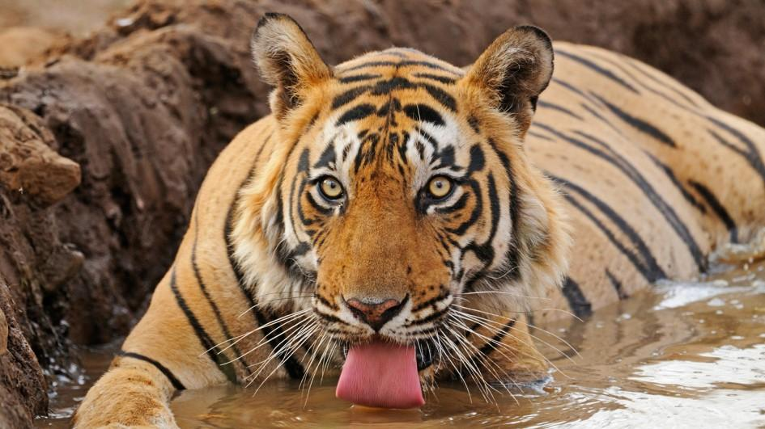
Why are they useful?
Allows us to reduce the dimensionality of in image by only extracting the important features.
By only extracting the important features on image, it allows us to recognize images that are not the same

Slide 4
Convolution?
Convolution is measuring how much two function overlap as one passes over the other (mixing two functions by multiplying them)
The green curve shows the convolution of the blue and red curves
With image analysis, the green static function is the input image being analyzed, and the second, mobile function is known as the filter

Slide 5
Convolutional nets in images
Many filters are applied over a single image
Convolutional networks take those filters, slices of the image’s feature space, and map them one by one; ie they create a map of each place that feature occurs
For example, in early layers… an image will most likely pass through a horizontal line filter, a vertical line filter, and a diagonal line filter to create a map of the edges in the image

Slide 6
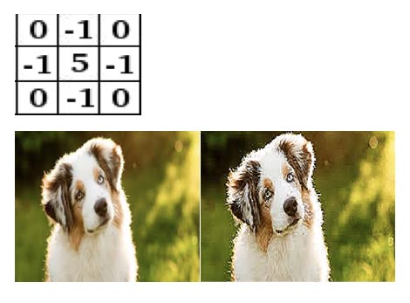
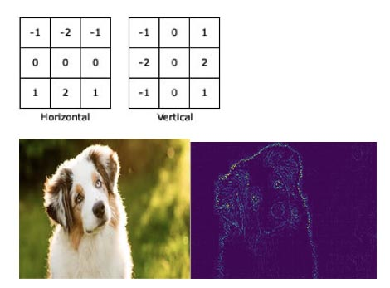
Some filters
Sobel filter (edge detection)
Sharpen an image filter
Many more…

Slide 7
Some terms
Stride is the size of the step. A larger stride leads to fewer steps, which means a smaller activation map. (less time to compute!!)
Padding is adding 0’s around the layers. This allows us to preserve as much information about the original input volume

Slide 8
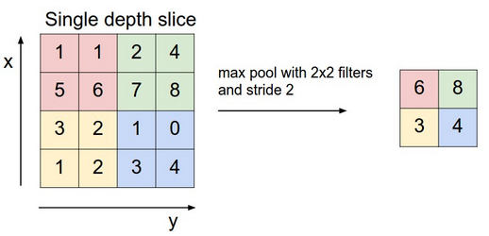
Max Pooling with CNN’s
A layer in a convolutional network
Takes the output layers and applies down sampling
In this example, only the locations on the image that showed the strongest correlation to each feature are preserved
Allows lesser values to be lost, decreasing the amount of storage and processing

Slide 9
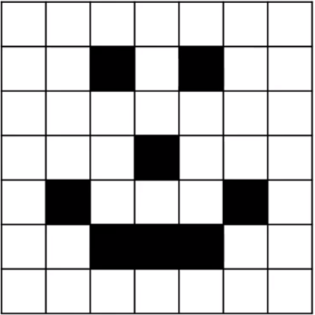
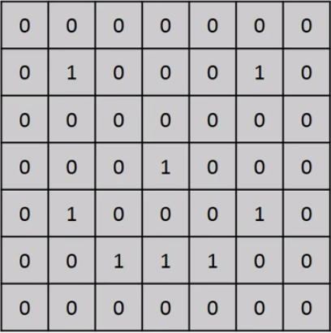
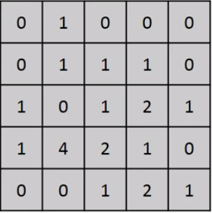
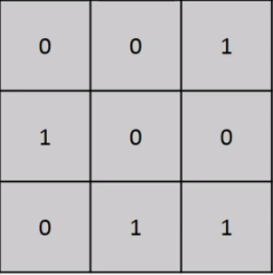
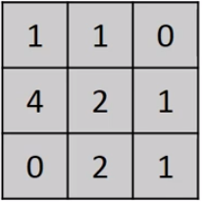
Example of pooling
=
Input Image
Filter/Feature
Detector
Feature Map
Pooled Feature
Map

Slide 10
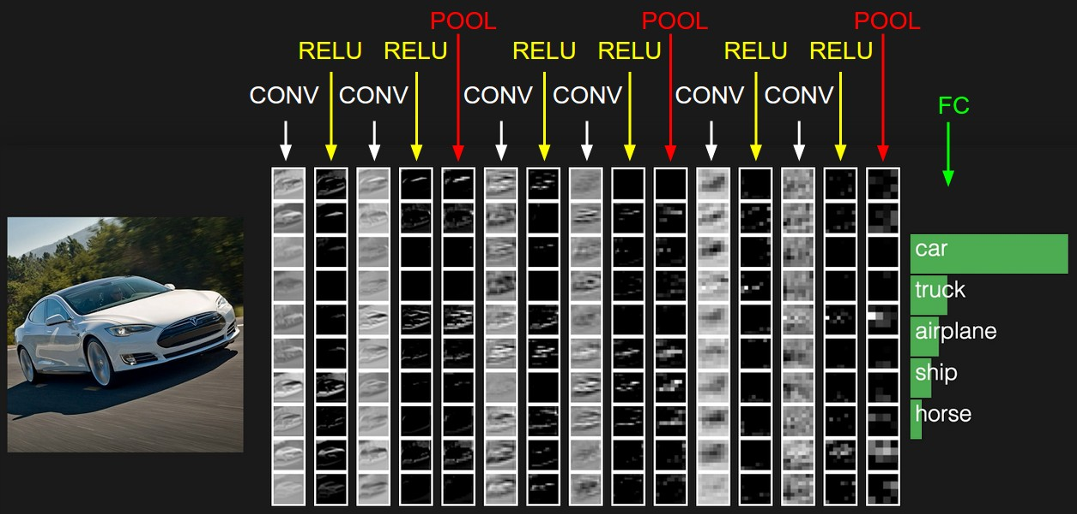
A typical CNN
scs.ryerson.ca/~aharley/vis/conv/flat.html

Slide 11
Some fun examples of CNN’s
How CNN’s see in the dark ( link )
NVIDIA’s driving car ( link )

Slide 12


TensorFlow and Keras
TensorFlow is an open-source software library for dataflow programming across a range of tasks… very used in machine learning applications
Keras is an open source neural network library written in Python. It runs on top of TensorFlow

Slide 13
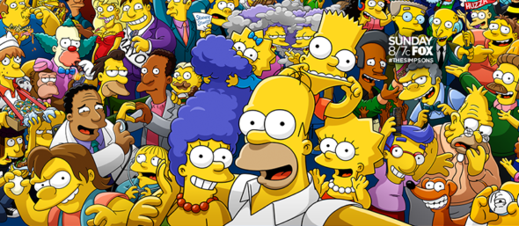
The Simpsons CNN!

Slide 14

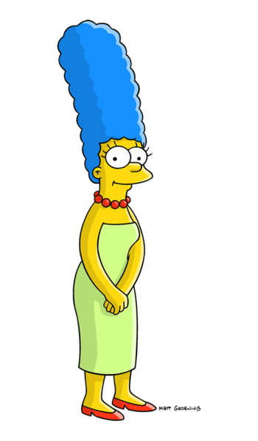
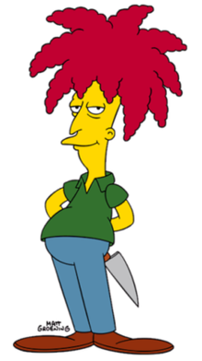
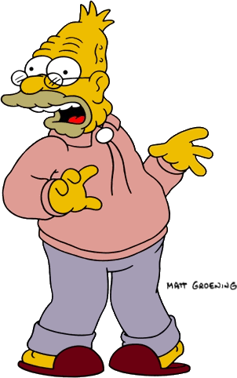
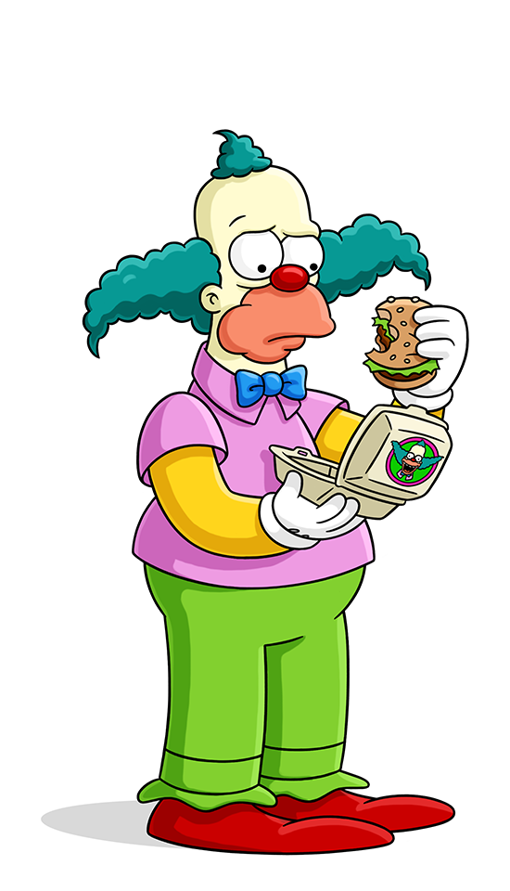


Goal: Classify the Simpsons characters
Sideshow Bob
Marge Simpson
Homer Simpson
Abraham Grampa Simpson
Krusty the Clown
Principal Skinner
Milhouse Van Houten

